Slide 1
MacGyvering a SharePoint Work Request Process for Power Users!
Jared Matfess
Solution Architect, Slalom
#SPSBOS

Slide 2


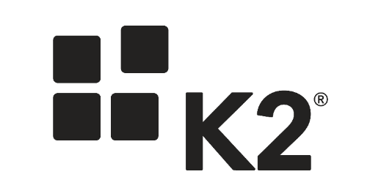







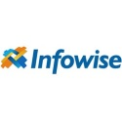


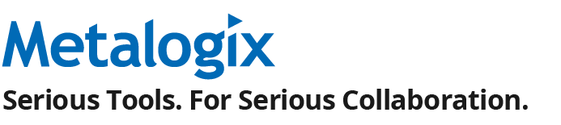




SPS Boston 2015 is made possible by our Sponsors

Slide 3


About Me
Solution Architect with Slalom Consulting
10+ years in the IT Field
Happily married for 4 years!
President of CT SharePoint Users Group (www.ctspug.org)
Blog: www.jaredmatfess.com
Twitter: @JaredMatfess
E-mail: JaredM@slalom.com

Slide 4
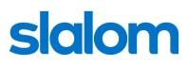
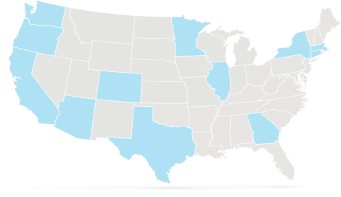





We bring business and technology expertise to help companies
Improve employee productivity
Improve enterprise performance
Drive innovation
Retain and grow customers
Key Differentiators
Balance of business and technology
National reach – locally based teams
Flexible, client focused delivery
Highly experienced consultants
SEATTLE (HQ)
PORTLAND
MINNEAPOLIS-ST. PAUL
BOSTON
SILICON VALLEY
CHICAGO
HARTFORD
SAN FRANCISCO
DENVER
NEW YORK
LOS ANGELES
PHOENIX
ATLANTA
DALLAS
HOUSTON
LONDON
Management Consulting Firm – Serving our Clients Locally
Founded in
Headquarters
3,000+
National Delivery Centers
13
2001
Seattle, WA
3
Employees Nationally
Years Strong

Slide 5







Areas of Expertise
We design and build strategies and systems to help our clients solve their most complex and interesting business challenges.
Improve collaboration, enhance IT efficiency, increase productivity, and engage customers through intuitive digital experiences.
Digital Strategy
Interactive Engineering
Experience Design
Product Incubation
Define your information architecture, taxonomy and governance strategy to not just connect your data, applications and people, but to empower them.
Software Engineering
Portals and Collaboration
Next Generation Infrastructure
Unleash business value from your processes and people through improvements in strategy, culture, and role clarity.
Change Management
Learning
Organization Design
Talent
Culture
Lead and Adopt Change
Realize the business value of your most strategic initiatives by making your methods and practices more agile to deliver results.
Program and Project Management
Business and Technical Analysis
Quality Assurance
Agile and Delivery
Link your strategic vision with executable techniques to gain alignment and drive untapped potential and value to your organization.
Strategy Advisory
Business Transformation
Performance Improvement
Mergers & Acquisitions
Create intimate, meaningful and authentic relationships that connect your customers to your brand by engaging with them on their terms.
CRM
Differentiated Digital Experiences
Marketing Execution
Customer Centric-Organizational Alignment
Customer Innovation Facilitation
Leverage the right data in your big data through a technology-agnostic approach to generate consumable information and enact solutions.
Data Visualization and Discovery
Information Strategy
Analytics
Data Management
Business Intelligence

Slide 6

“I call it an obstacle course. Some of the others call it MacGyverland.”
Angus “Mac” MacGyver
Notes:
Quote Sample

Slide 7
What am I covering?
A quick primer on what the heck is an intake process
What to watch out for
Recent Case Study of an Intake Process
Utility functions that might be helpful
Demo

Slide 8

On the fence about staying??
What am I going to be using?
SharePoint Designer Workflows
InfoPath
List view web parts with some filters
A sprinkle of JavaScript
Some pseudo-best practices

Slide 9

Tips for Surviving the Session
If you ask me a question such as “Couldn’t you have ….”
The answer could be yes, but I didn’t do it that way..
There’s going to be pictures of pugs..
The slides will be made available, no need for taking pics with your iPads ☺

Slide 10
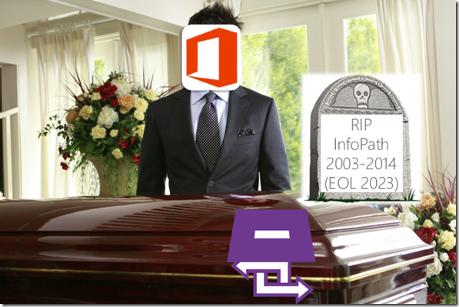
InfoPath is still alive…
InfoPath will still be supported in SharePoint 2016
http://blogs.office.com/2014/01/31/update-on-infopath-and-sharepoint-forms/

Slide 11

Quick rant on out of the box….
Notes:
Quick discussion about how out of the box is changing – even by Microsoft. It’s encouraging / recommending more customizations but doing so in a less harmful way. (Client side development) As users become savvy, you are going to see them building more of these hybrid solutions that leverage SharePoint web parts + client side development.

Slide 12
So what is an intake process?

Slide 14

Real-world Examples:
SharePoint Site Collection Request
Employee travel/vacation request
Purchasing request
Light-weight Help Desk process

Slide 15

Why in SharePoint?
Because people will think you’re a total rock star!

Slide 16
Things you need to watch out for…

Slide 17

List view throttling

Slide 18

Promotion of content

Slide 19

Approaches for promoting content
Site Collection Backup & Restore
3rd Party ISV (ShareGate, AvePoint, Metalogix)
Manual recreation
SharePoint Export/Import – don’t

Slide 20

Security or Obscurity?
How sensitive are your requests?
Search or don’t search?
Break inheritance on list items?
“App Step (Step-by-Step) break permissions inheritance on item https://msdn.microsoft.com/en-us/library/office/jj822159.aspx

Slide 21
There once was an intake process….

Slide 22
What I walked into….
Work intake process with 3 SharePoint lists (300+ columns)
Submitter list, project manager list, executive leadership list
Single content types containing the 300 columns
SharePoint 2010 workflows performing “sync operations”
3 InfoPath forms with 5 unique views
Security model with “All Authenticated Users” having Full Control to the site

Slide 23

What I did next…

Slide 24

Digging a little bit deeper..
Limited documentation available
Copy item workflows result in delays between operations
Also introduced complexity when adding new functionality
Prone to frequent failure
InfoPath performance not great (likely from having to load so many columns)
Also was confusing since all tabs would be visible so users wouldn’t know what was most relevant at that stage
Data wasn’t considered sensitive, so security model was focused on enabling correct usage vs trying to prevent malicious activity

Slide 25
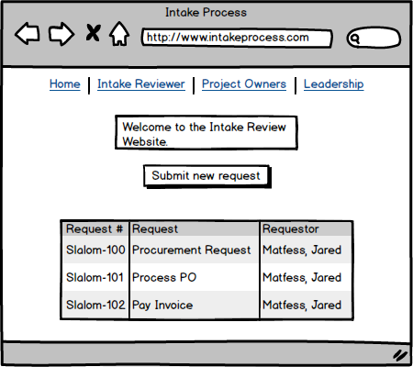
Intake Review Website
Audience Targeting
for navigation

Slide 26

Key Points on Audience Targeting
Audience targeting is not Security!
Users will still have access to backend lists based on security groups
Search will not trim any of those results
Audience targeting is a good way to surface information to specific user populations

Slide 27

My objectives
Consolidate 3 main lists into a single list
Eventually reduce column count
Reduce 7+ workflows into 2
New item create
Edit item
Improve forms experience so users would only see relevant tabs
Maintain InfoPath forms – do not convert to custom development solution
Leverage SharePoint out-of-the-box where appropriate, supplement with JavaScript

Slide 28
Addressing the workflows
Multiple SharePoint 2013 reusable workflows
New item create workflow updates request item category based on choice values
Creates items in supporting lists
Several SharePoint 2010 workflows for copy item (sync steps) between lists
Sometimes these would collide with each other
Delays in processing to the next step of the process

Slide 29
Reusable Workflows or List Workflows
Reusable workflows are fantastic when you plan to reuse them across multiple lists
They increase the amount of development time if you are making lots of list item updates or changes
You have to find the item which you plan to update via some property (GUID, Unique ID, etc.) vs leveraging “Current Item” which is the List item that the workflow is running against
One downside is you can’t easily migrate List workflow between environments* without 3rd party products
Notes:
Reminder – 2010 style workflows you can copy (access via All Files in SPD)

Slide 30
Addressing the forms
Ideally I would have loved to replace the forms with something besides InfoPath
Nintex Forms
K2 Forms
Custom JavaScript forms
Having separate lists enabled a different default view per InfoPath Form
3x lists
3x forms
3x default views
Problem Statement: How do we define rules for different people if sharing the same form?

Slide 31

Ideal “Future State”
Single InfoPath Form (5 views)
2 SharePoint Designer 2013 workflows
No calling of SP2010 workflows for Copy Item tasks
Reduce column count

Slide 32
Demo
“Some tips & tricks”

Slide 33
Utility Functions

Slide 34
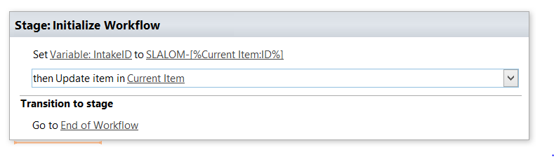
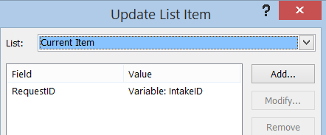
Pro-Tip: How to create a Request ID
Notes:
SharePoint will automatically assign your items ID numbers. You can always do some sort of a concatenation with the Item ID plus whatever naming scheme you have. This example is Slalom-ID (Item ID number)

Slide 35
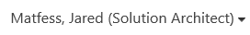
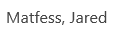
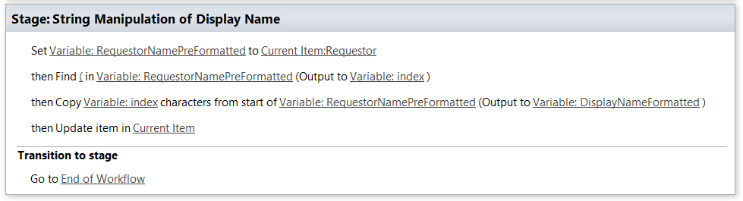
Pro-Tip: String Manipulation not like String Theory!
Notes:
Step through the

Slide 36
How to promote InfoPath Form across environments

Slide 37
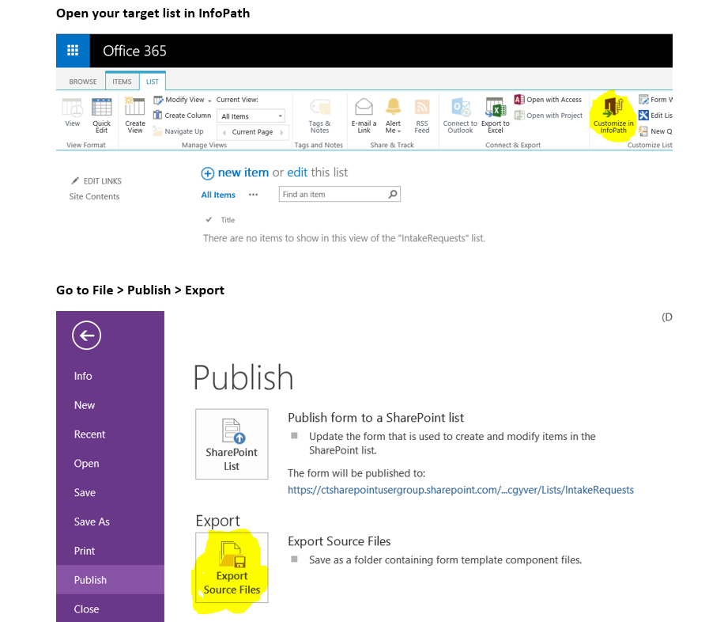

Slide 38
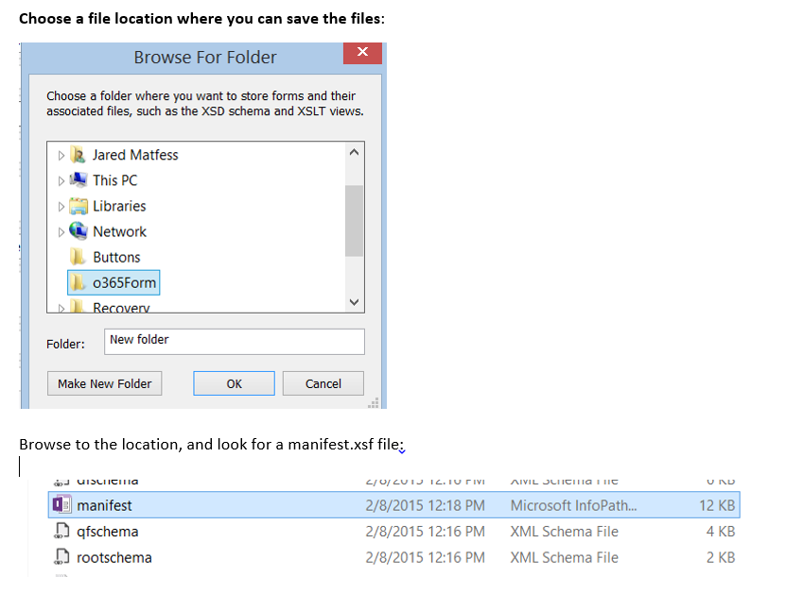

Slide 39
Find this key line in the manifest.xsf
Do a Ctrl + F for the siteURL value in the manifest file
Update the siteURL to point to your new environment
You might need to update the GUIDs for sharePointListID & contentType
Right click on the manifest.xsf and select Design
Publish as normal

Slide 40
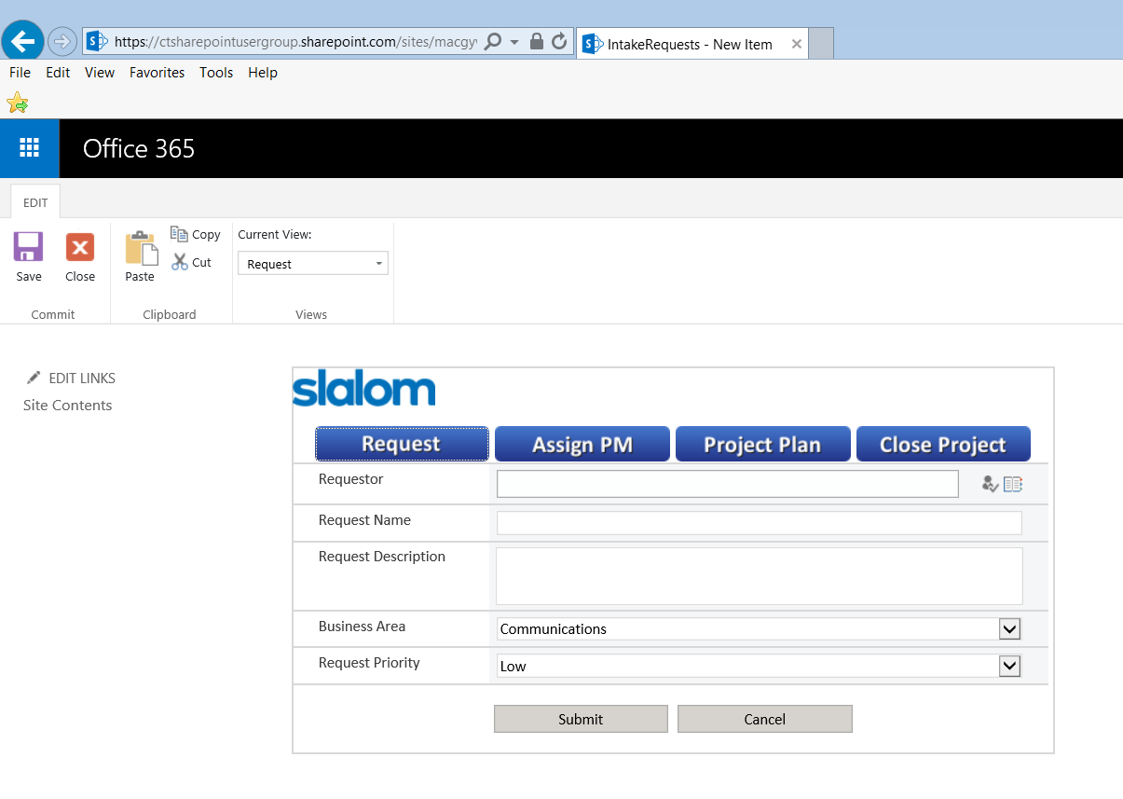
Success!

Slide 41
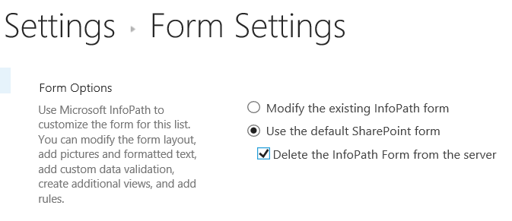
Pro-Tip: Promoting to site with InfoPath Form already
If you’re promoting an InfoPath form to a site where there’s already an existing InfoPath Form (use case of application enhancements) – sometimes things go bad
Don’t be afraid of nuke the existing form out of existence!

Slide 42
Step by Step: Building a SP2013 Workflow with a Loop Step

Slide 43
Background & Use Case
Loops are incredibly powerful just like in application development
SharePoint 2013 includes a new Loop step which allows you to iterate through a collection of items
It’s also pretty poorly documented on the Internet ☺

Slide 44
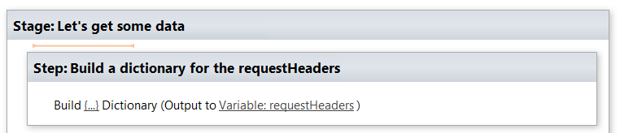
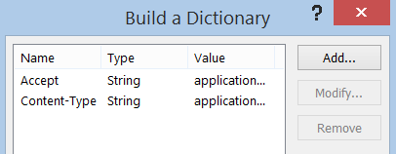
1. Create a dictionary with Accept & Content-Type
Value = application/json;odata=verbose

Slide 45
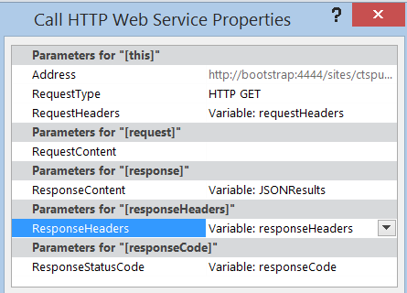
2. Add a call a web service action
* Each variable is of Dictionary
http://bootstrap:4444/sites/ctspug/_api/web/lists/getbytitle('Fake%20Data')/items?select=Title,RequestID

Slide 46
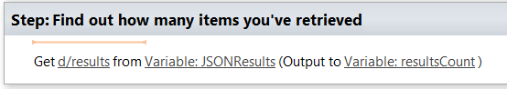
3. Find out how many items you’re looping through
Add a “Get an Item from a Dictionary” action
Retrieve d/results from previous JSONResults dictionary
Output to the resultsCount variable (dictionary)

Slide 47
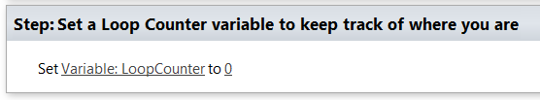
4. Create a Loop Counter variable
Most examples on the Internet forget to include this vital step for actually traversing through each list item

Slide 48
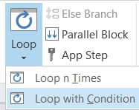
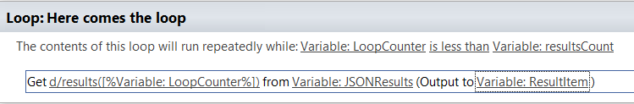
5. Start to build out your loop
Add a Loop with Condition action
Set the condition of LoopCounter is less than resultsCount
resultsCount is how many items were retrieved via the web service call
Add a Get item from Dictionary step
d/results([%Variable: LoopCounter%]) from JSONResults dictionary
Output to new Dictionary variable called ResultItem

Slide 49
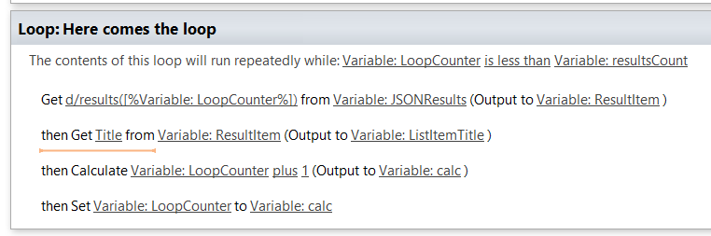
6. Complete loop
Add get Item from Dictionary action – remember to use *internal* column name
Calculate the LoopCounter + 1 to increment the counter
Assign the Loop counter it’s new value

Slide 50
In Closing…..

Slide 51
Summary
Intake processes can be fun, if that’s your thing…
Loops are awesome, check them out..
You might need to dabble in some JavaScript here and there..
Remember to tip your waiter

Slide 52
Resources
GitHub – Awesome Source Code!! https://github.com/JaredMatfess/SPSBoston2015
JSLink CSR (Production code): https://github.com/spcsr
SharePoint REST Endpoints https://msdn.microsoft.com/en-us/library/office/ff521587(v=office.14).aspx
Great multi-part series on REST https://chrisstahl.wordpress.com/2014/05/29/getting-started-with-rest-in-sharepoint-2013-part-i/

